Slide 1
AlphaZero and Control
How to control dynamical systems with a board game AI
Notes:
AlphaZero is a RL algorithm developed by Google DeepMind.
It is a general AI that can play a wide range of board games, and is currently the reigning world champion in both chess and Go.
It can be thought of as a robust model predictive control algorithm that performs a directed tree search to return a control action, rather than optimising over all future states in a receding horizon

Slide 2
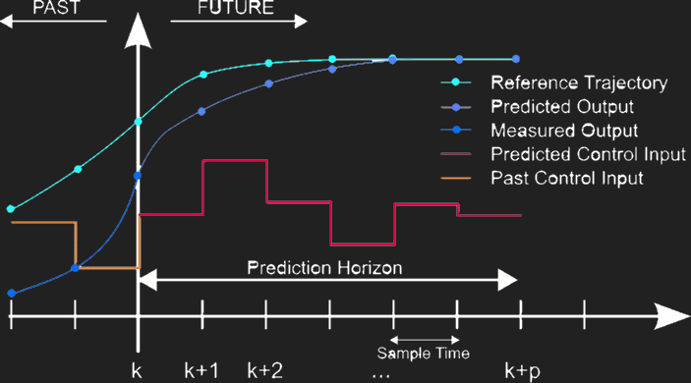
Robust Control
Robust MPC
Adversary = “Worst Case Disturbance”
Works on non-linear systems
Can create pseudo-continuous control
Notes:
If you did 3F3 we learnt that MPC uses a receding horizon to look ahead and return its next action
in this way, AlphaZero is very similar as the tree search is like a receding horizon
Episodes are played by taking turns between a player and an adversary, both of which are trained via reinforcement learning.
This massively improves on MPC because the player takes into account what it thinks an optimal adversary would do.
The adversary can be thought of as a series of optimally adverse disturbances, or the “worst case scenario”
Which theoretically trains the controller to be robust against any disturbances that it faces
Other potential benefits:
Non-Linear Systems as tree search will work with any deterministic system
Easily applied to many dynamical systems as long as you know the dynamics and have enough computing power.
The faster the control inputs, the better they approximate continuous control.
So theoretically AlphaZero can be made into a Robust to disturbances, pseudo-continuous MPC algorithm

Slide 3
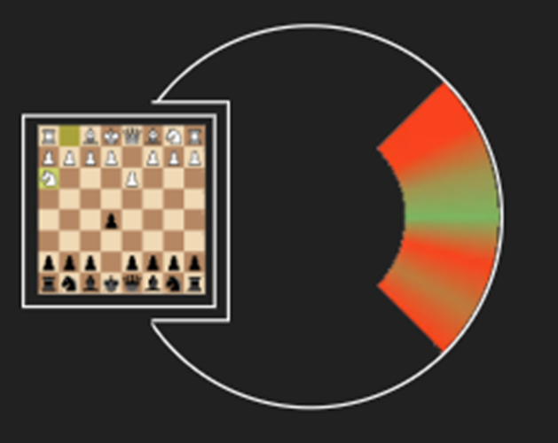
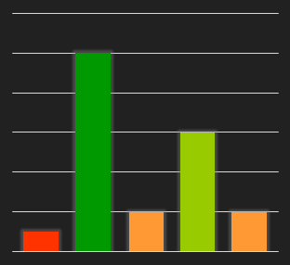
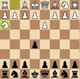

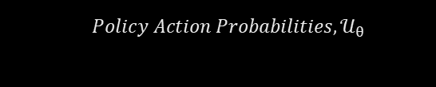
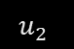
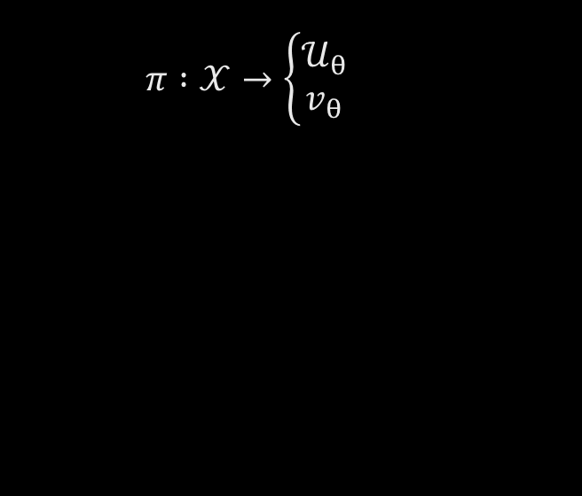

(1) Initial Policy
$$π :𝒳→\left\{\begin{matrix}𝒰_{θ} \\ v_{θ}\end{matrix}\right.$$
$$Policy Action Probabilities,𝒰_{θ}$$
$$u_{2}$$
$$v_{θ}$$
$$u_{1} u_{2} u_{3} u_{4} { u}_{5}$$
Notes:
What AlphaZero is trying to create is a function that will take some board state as input and output a very high quality move that we can make.
There are two clever algorithms that AlphaZero uses:
The first is a neural network, which represents the AI’s intuition of how good a move is. It output’s:
A pmf over actions, that represents how good it thinks the move is
A value, which represents the expected game outcome where -1 = certain loss and +1 = certain win, with all the values in between.
Once you have this, the obvious next step is to just do an argmax – take what looks like the best move.
But we can do better, this leads to the second algorithm

Slide 4
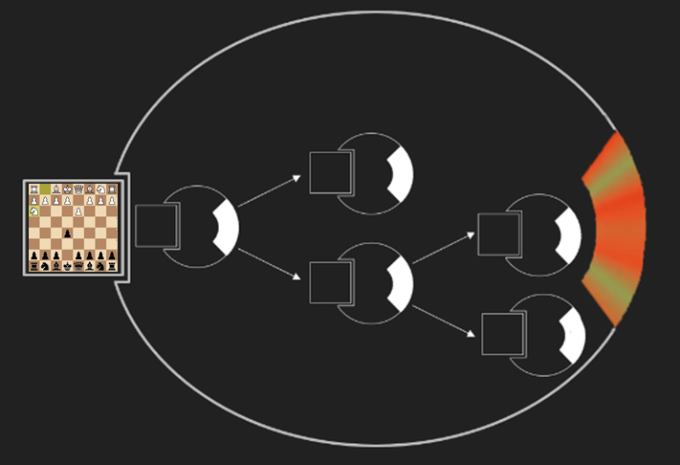
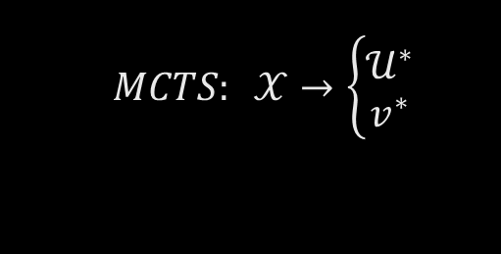
(2) Look Ahead
Monte-Carlo Tree Search
$$MCTS: 𝒳→\left\{\begin{matrix}𝒰^{∗} \\ v^{∗}\end{matrix}\right.$$
Notes:
The second algorithm is a MCTS, which drastically improves the p.m.f. over the actions that we initially guessed, and also the expected value
If we look ahead and apply the neural network again and again, alternating between the adversary and player’s turns.
there might be some move that looked good initially, but now you’ve seen what the adversary will do and what you would then do
A different move looks better
This directed tree search dramatically reduces computational time since we don’t have to do an exhaustive search, we just look at the most likely paths.
For example in it’s match against the previous reigning chess AI, stockfish, it only looked at 20,000 possible branches, whereas stockfish looked at 3bn per move played

Slide 5
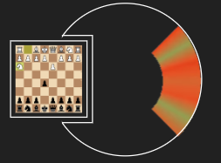
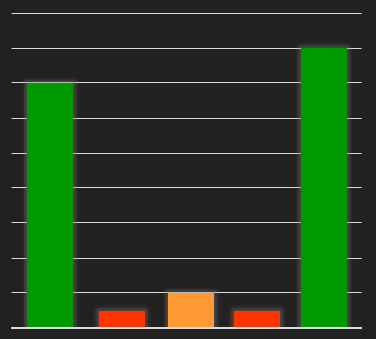




(3) Train the Network on Better Moves
$$\left.\begin{matrix}𝒰^{∗} \\ v^{∗}\end{matrix}\right\}→π(𝒳)$$
$MCTS Action Probabilities$, $𝒰^{∗}$
$$v^{∗}$$
$$u_{1} u_{2} { u}_{3} { u}_{4} { u}_{5}$$
Notes:
We can then take this improved pmf and value for the state and retrain the neural network on these
In this way, we can improve through playing another agent
And then we can do this again and again continually improving our policy/neural network

Slide 6
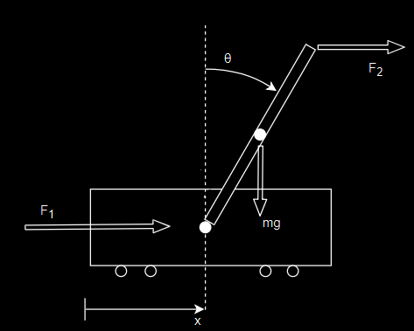
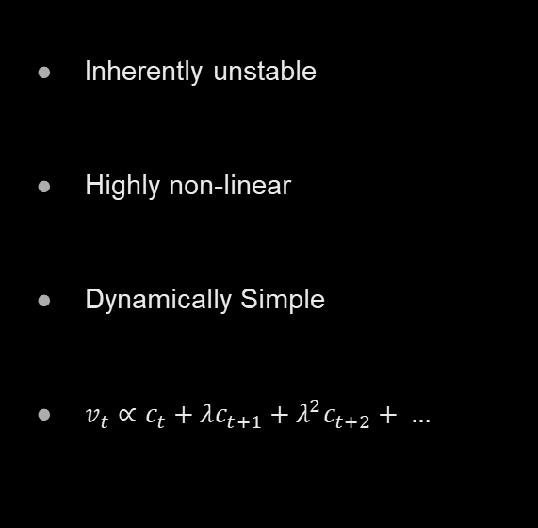
Inverted Pendulum
Inherently unstable
Highly non-linear
Dynamically Simple
$v_{t}∝c_{t}+λc_{t+1}+λ^{2}c_{t+2}+ …$
Notes:
As a test-bed the inverted pendulum was chosen because it has some good qualities: Inherently unstable, highly non-linear, dynamically simple
The player was chosen to act with just +1, -1 at F_1
The adversary was chosen to act +1, -1 at F_2.
The cost of each state is a measure of how far away from the unstable equilibrium the IP is
Conversely to the player, the adversary tries to increase the cost
The adversary was chosen to act at F_2 so that two distinct policies are learnt – rather than one just outputting inverse probabilities of the other
There are two neural networks, one for the adversary and one for the player.
They take turns with the state and output an expected value and an action pmf.
With the IP the episodes can last indefinitely and there is no easily discernible winner – therefore cant use expected outcome for the value
The true value is the DISCOUNTED FUTURE COSTS and is calculated after an episode is completed as it needs to know the future state

Slide 7
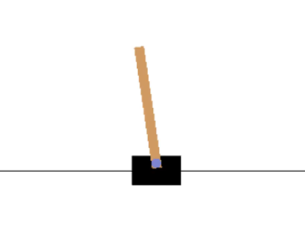
Power Matching
Notes:
One of the most difficult questions was how powerful the adversary should be.
The adversary has the advantage of gravity and it’s actions are more powerful for the same force.
We can work out roughly how much more powerful it is by finding what force from each agent gives the same angular acceleration of the pendulum
However due to non-linearities and differing accelerations at the base, this does not make them equal. In fact making them equal is almost impossible
Adding a “roughly equal” adversary initially causes the pendulum to fall instantly, which leads to no training examples.
Therefore a much weaker adversary must initially be used.
The solution tried was pretraining the player without an adversary, and then introducing a handicapped adversary.
The adversary must always be weaker – or have less of an effect on the system than the player.
This is so that the player has at least some chance of balancing the pendulum when fully trained.
Theoretically this shouldn’t be an issue for the adversary as it should be able to capitalise on errors that the player makes.
For example, using a traditional optimal controller it is easy to push the pendulum over by applying force at the natural frequency of the pendulum, resonating it into falling.

Slide 8
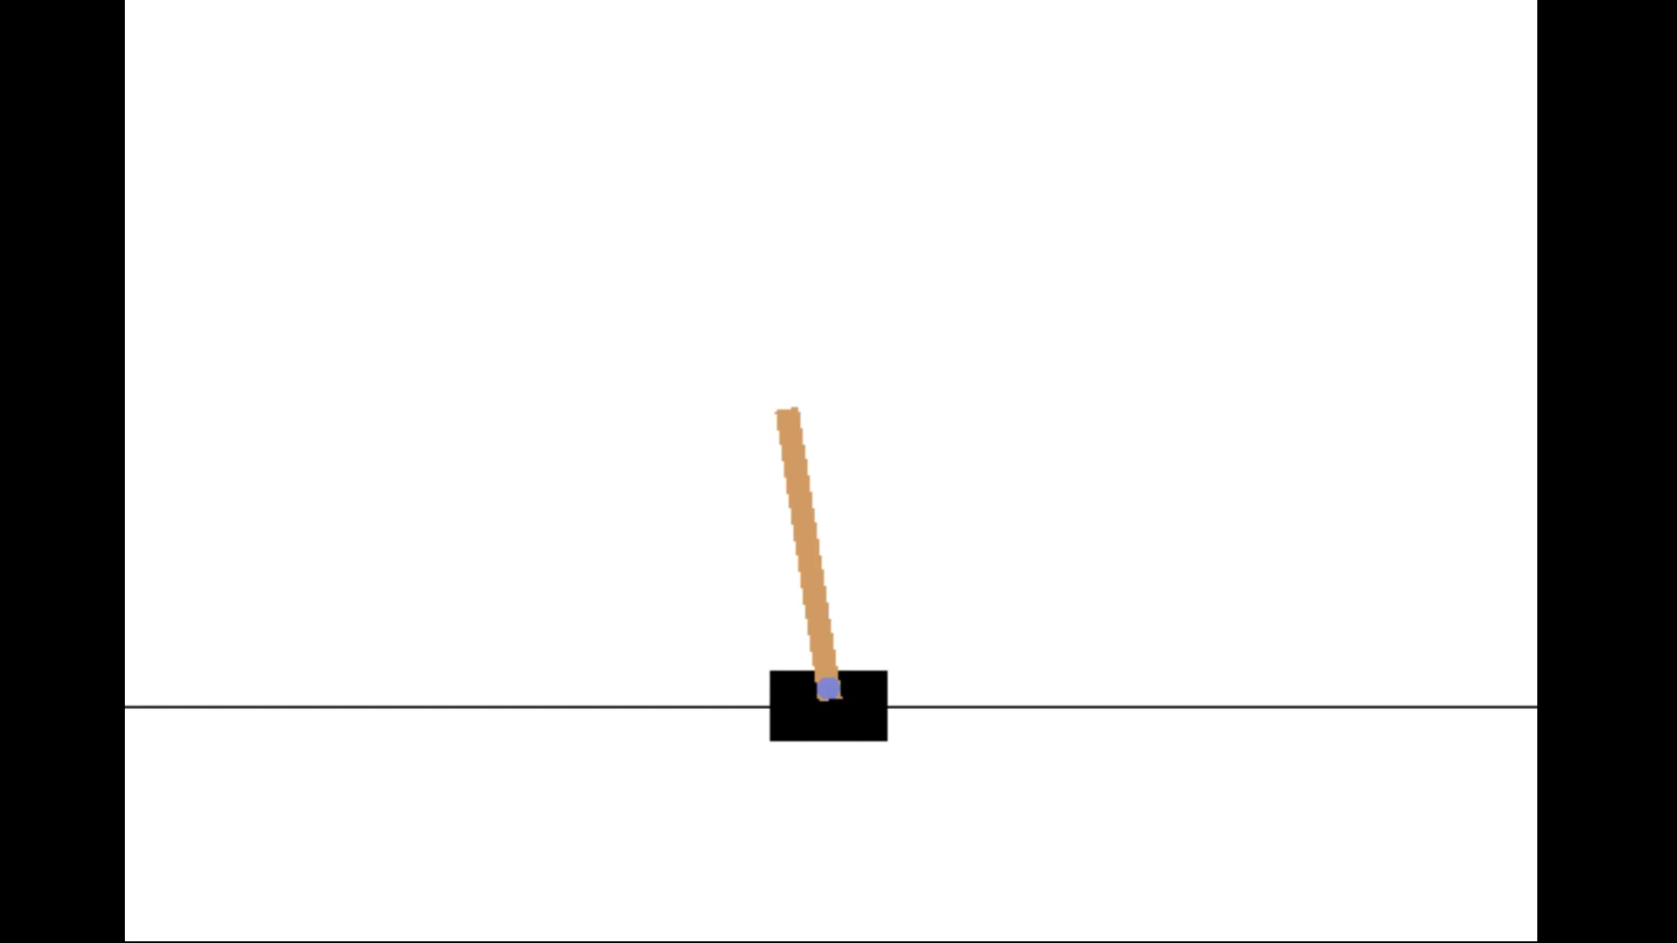
Untrained Player, No Adversary
Notes:
This is what happens when the player, pushing along the bottom, has had no training and is relying on just the monte-carlo tree search to look ahead to determine the moves it makes
The MCTS is much better than playing at random
But even with no adversary the player has a hard time balancing the pendulum if it’s not trained

Slide 9
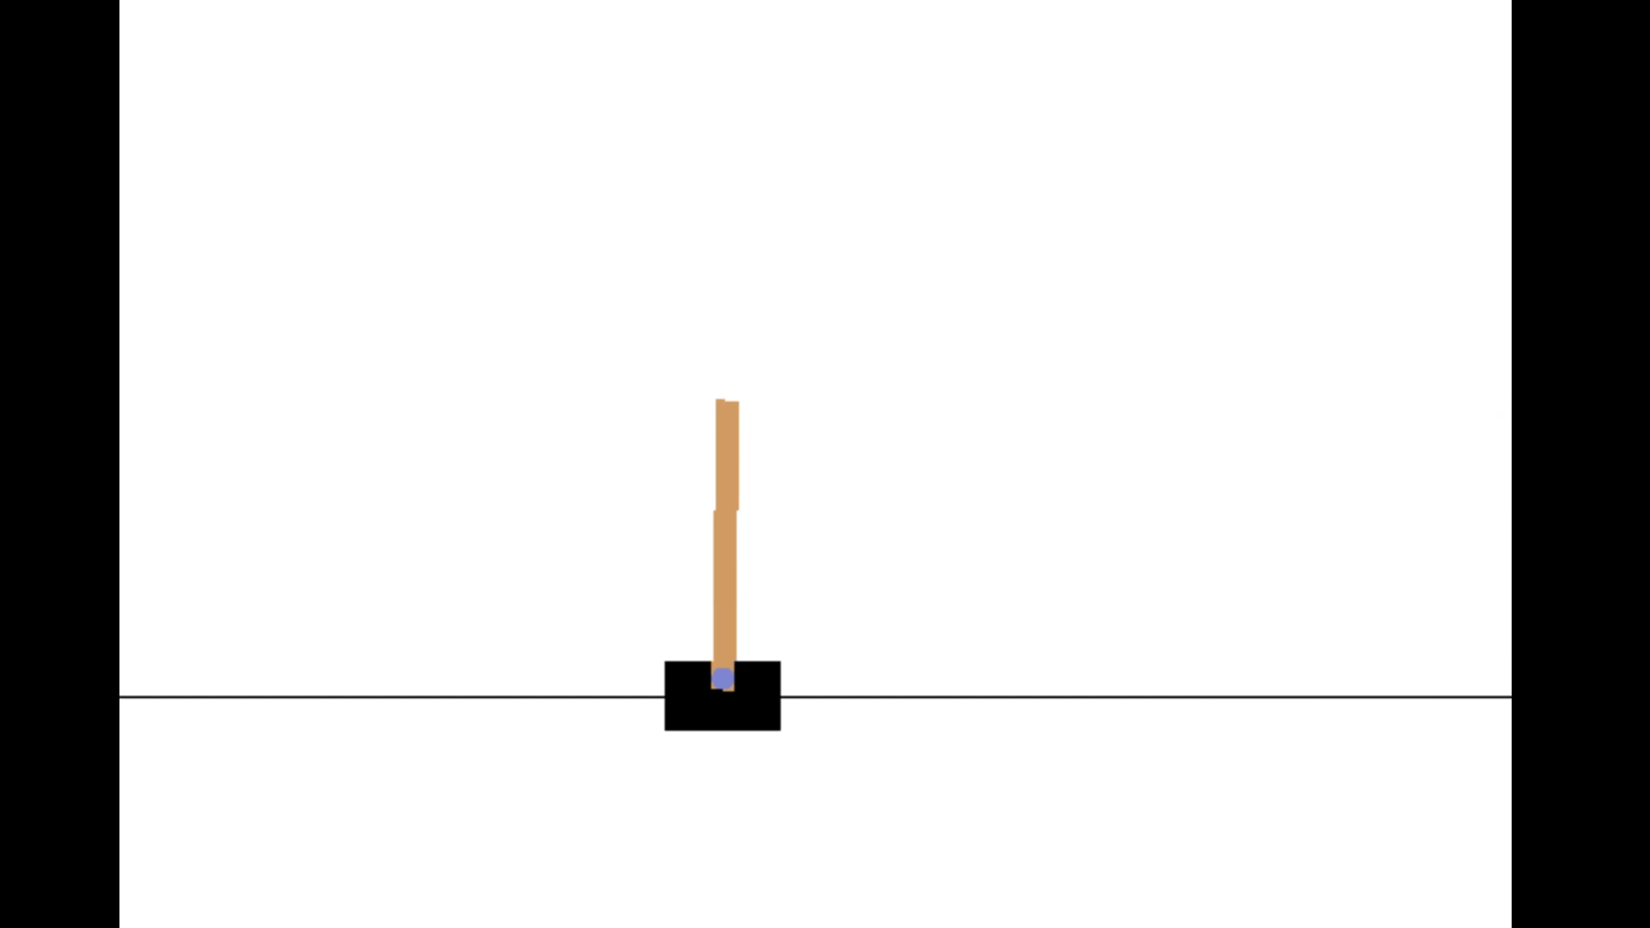
Trained Player
Constant Adversarial Force
Notes:
Doing this, and then adding an adversary and training it as well gives something like this
It starts off well, sort of resting the pendulum against the adversary.
But the cost is constant for this – which the player doesn’t like, so it tries to move towards the middle to reduce this
Which it achieves, but then finds that it cannot balance against the adversarial weight in the middle
So it drifts to the right, slowly increasing its distance from the centre and therefore the cost
And in this way, the adversary wins slowly

Slide 10
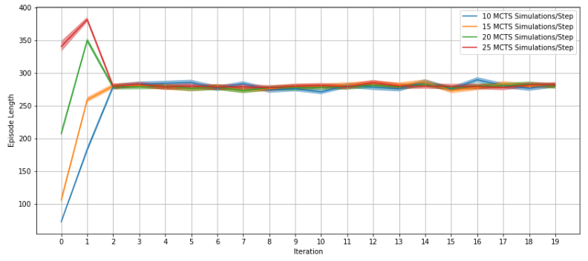

Conclusions
$$F_{t}=λF_{t−1}+\left(1−λ\right)u_{t}$$
Notes:
This is the main problem with using AlphaZero for a control application.
The worst case adversary isn’t necessarily the same as the opposite of the best action.
For the IP, the adversary learnt a long-term strategy since it could not beat the player by simply over powering it.
Needless to say, the player having an internal model of an adversary that only pushes in one direction does not generalise well to random adversaries.
With a random adversary, every time it pushes the way in which the player is not expecting, the tree essentially resets, making the tree only as deep
As the average time between when the adversary makes an unexpected move
This means that once a trained adversary is introduced, the performance of the controller is pretty much constant.
One possible way to overcome this “over training” of the adversary would be to make the system more realistic
For example adding a first order lag may allow the adversary to take advantage of the resonance of the system and push it over.
However, there was not enough time to include this

Slide 11
Questions?

Slide 12
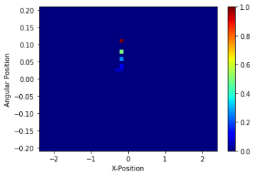
Notes:
How did you represent the state?

Slide 13
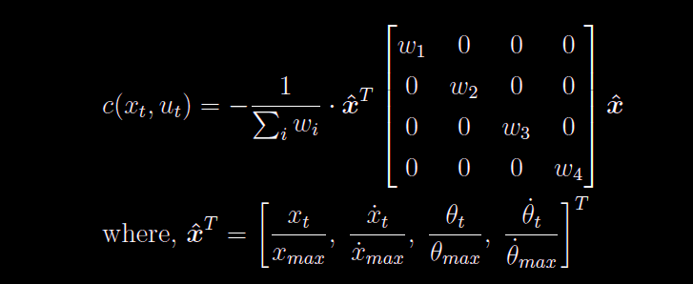
Notes:
How is the cost computed?

Slide 14
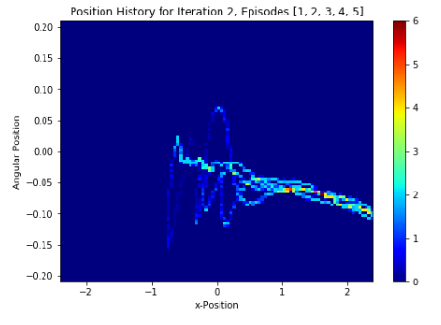
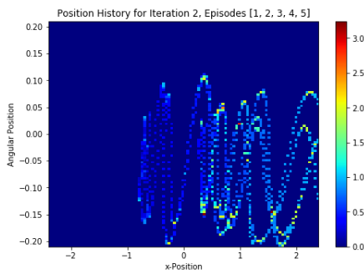
Notes:
What type of neural network did you use?

Slide 15
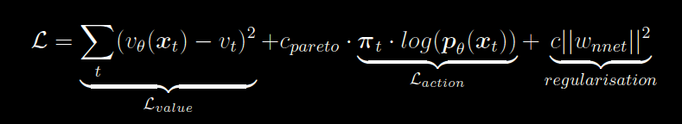
Notes:
How is the neural network trained?

Slide 16
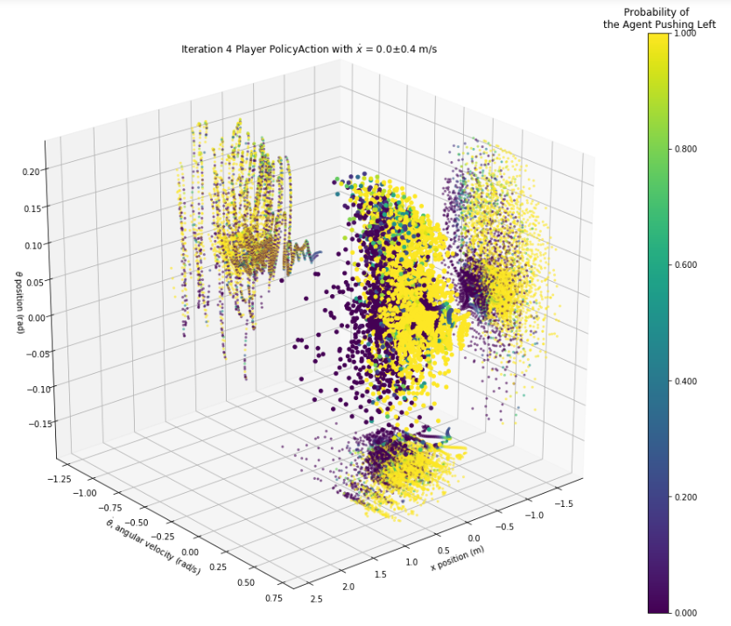
Notes:
How well did the neural network learn?
How do you know the adversary was acting optimally

Slide 17
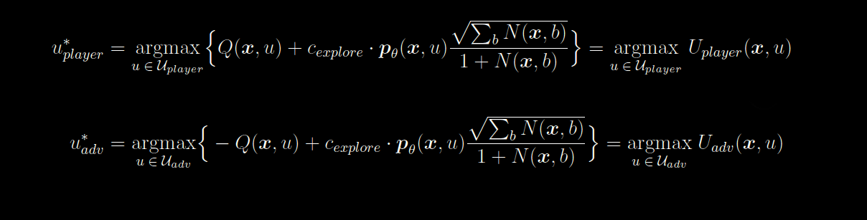
Notes:
How does the directed tree search/MCTS work?

Slide 18
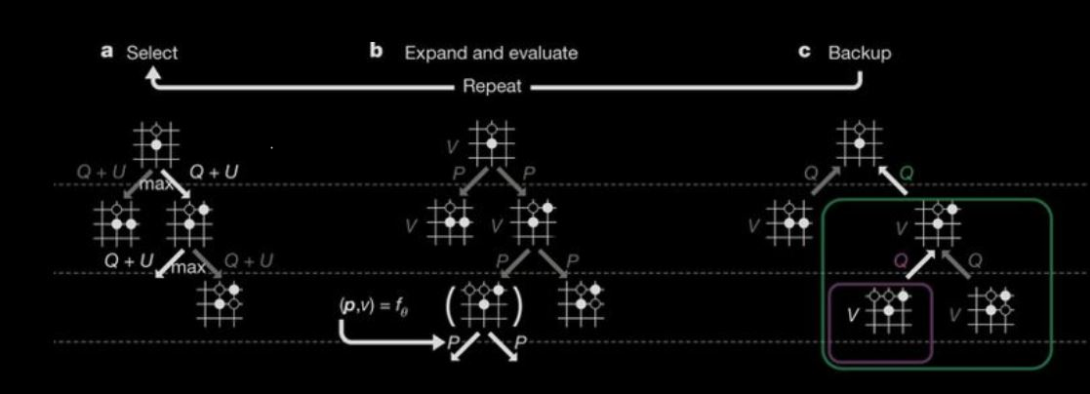
Notes:
How does the MCTS work?

Slide 19
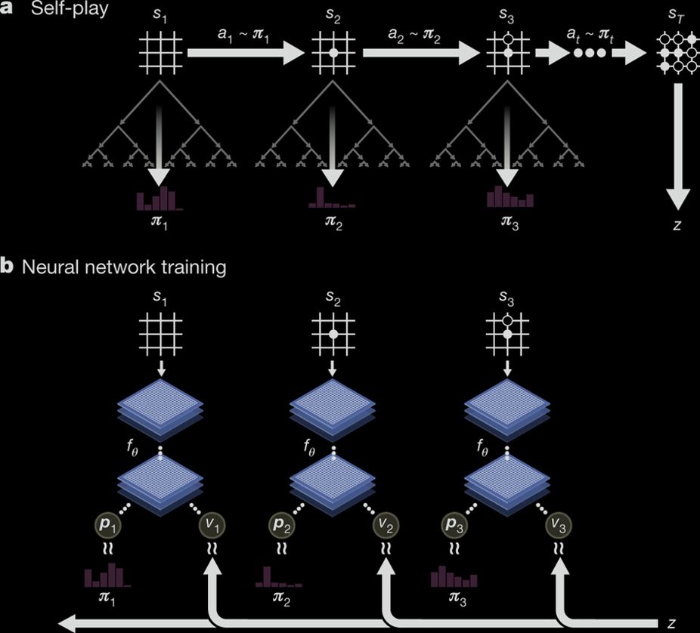
Notes:
How does self-play and training work?

